Slide 1
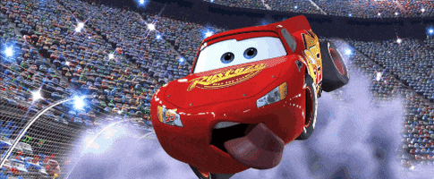
Car Accident analysis By crash dummies 2.0!
Members: Arnold Wamulanga, Thomas Lawless, Shreya Udeshi

Slide 2
Table of contents
Introduction
Extract & Clean
Visualization
Analysis
Results
Conclusion

Slide 3
Introduction
The U.S. Department of Transportation, National Highway Traffic Safety Administration issued a car crash report.
Accidents in 2019 appear to related to a lot of variables but we will be looking into depth for the following: accidents, people and vehicles.

Slide 4


Slide 5
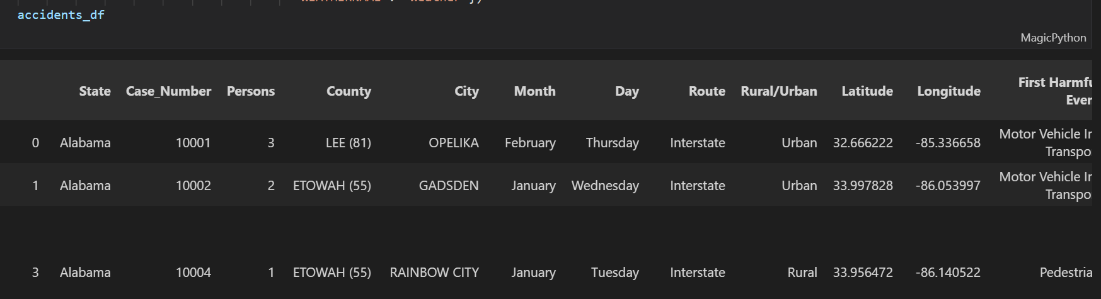
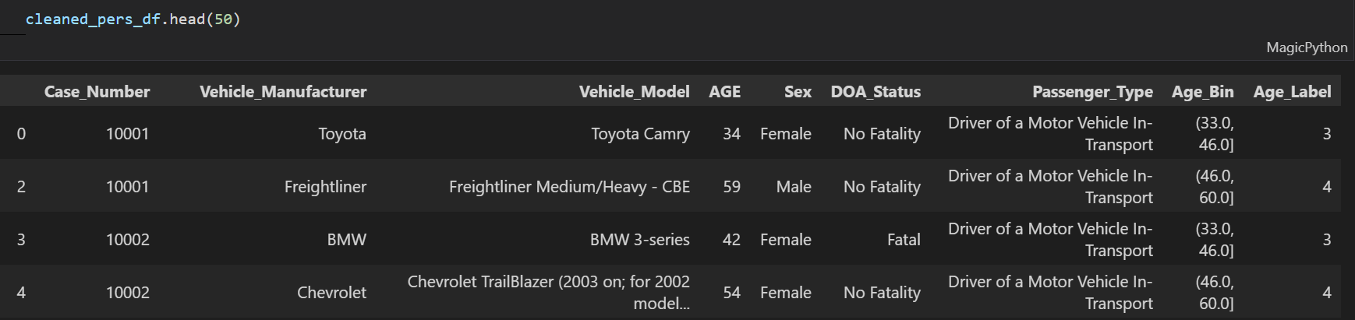
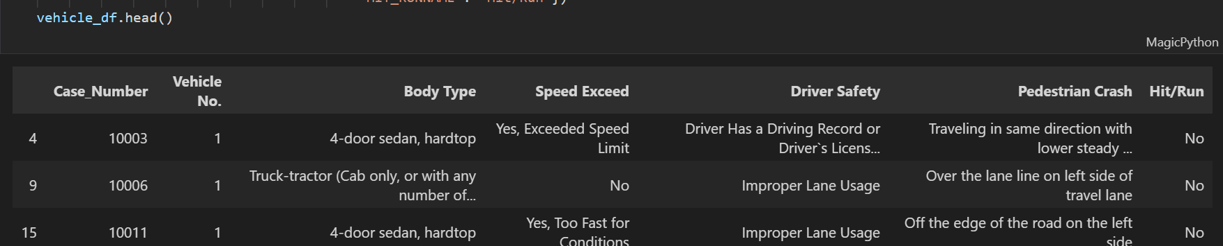
Extracting & Cleaning data

Slide 6
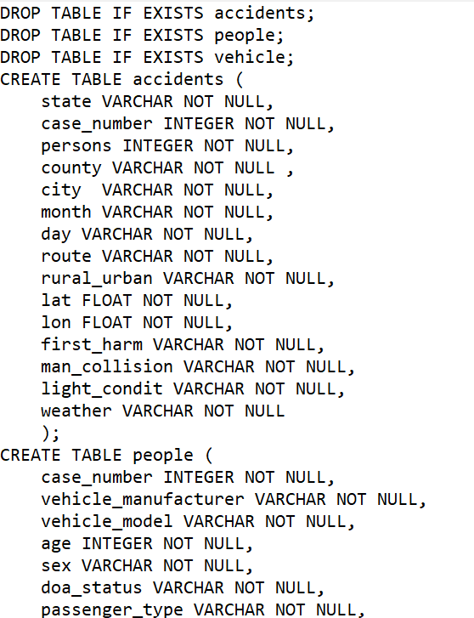
Create DB on PGADMIN

Slide 7
Plots

Slide 8
Final HTML Page

Slide 9
Conclusion

Slide 10

Thank you!

